Slide 1

NU ASSIST
Jay Mithani
Siddhesh Naik
Navya Sushma Thodimaladinne
Danish Shaikh

Slide 2
TEAM WORK
JAY: Backend API creation and integration
SIDDHESH: Signup/Login page creation, Content Designing and overall CSS
NAVYA : Content and Home, Accomodation page creation
DANISH : Courses and Food page creation

Slide 3
PROBLEM STATEMENT
New students find it difficult to obtain different sources of information regarding their stay, eating joints, and schoolwork, and the only option is to connect internally through student ambassadors and official websites and search around while sitting in their home country.
The confusion and helplessness is overwhelming.
Students may not understand whom to approach for all their queries.

Slide 4
SOLUTION AND APPROACH
Nu Assist will be a one stop website to get the information needed and connect with other seekers of information related to north-eastern university.
We gathered data from many northeastern university portals and compiled it on one webpage. As a result, consumers may easily obtain the information they want without having to visit separate websites.

Slide 5
TECHNOLOGIES USED
HTML/CSS
Bootstrap
Javascript
React JS
Node JS
MongoDB

Slide 6
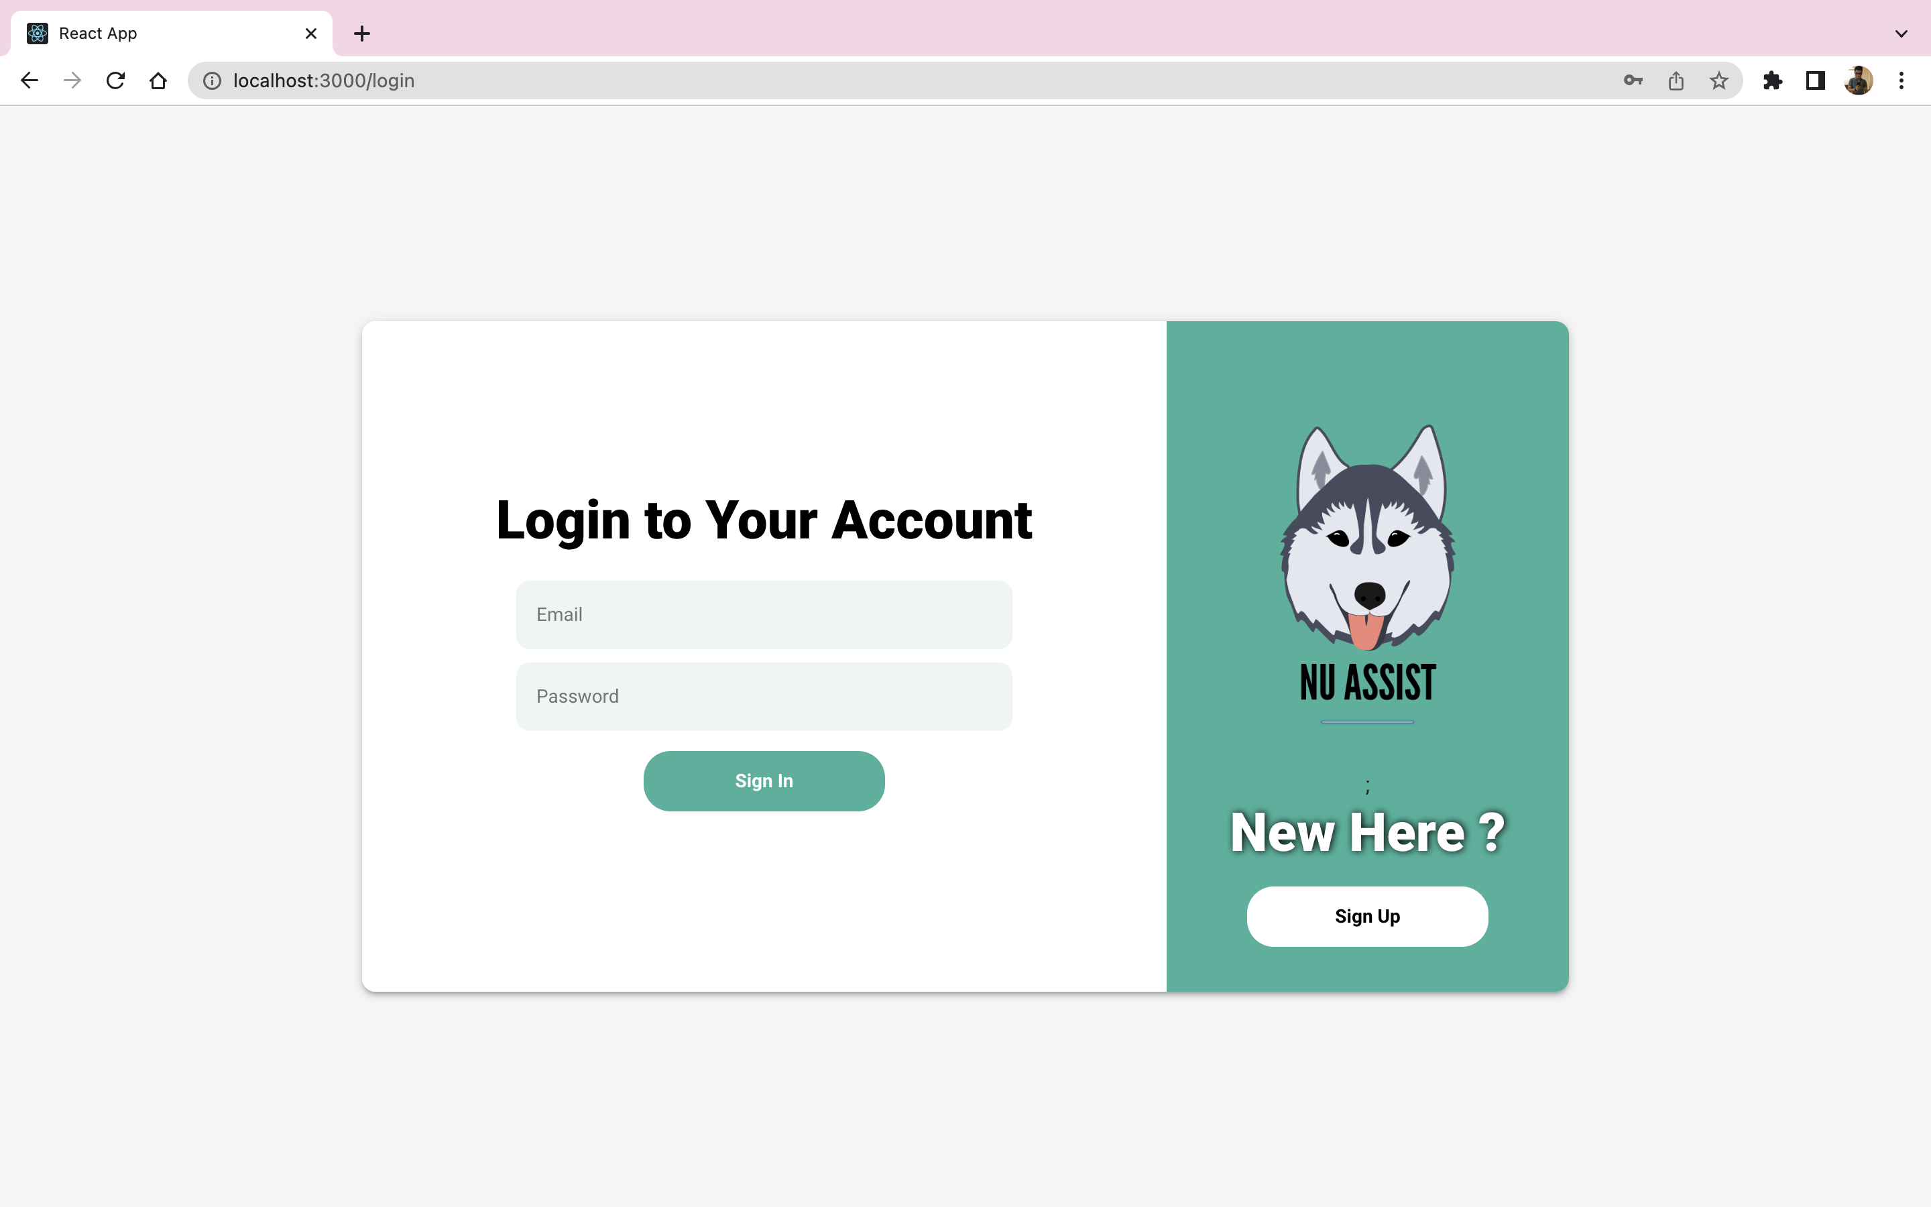
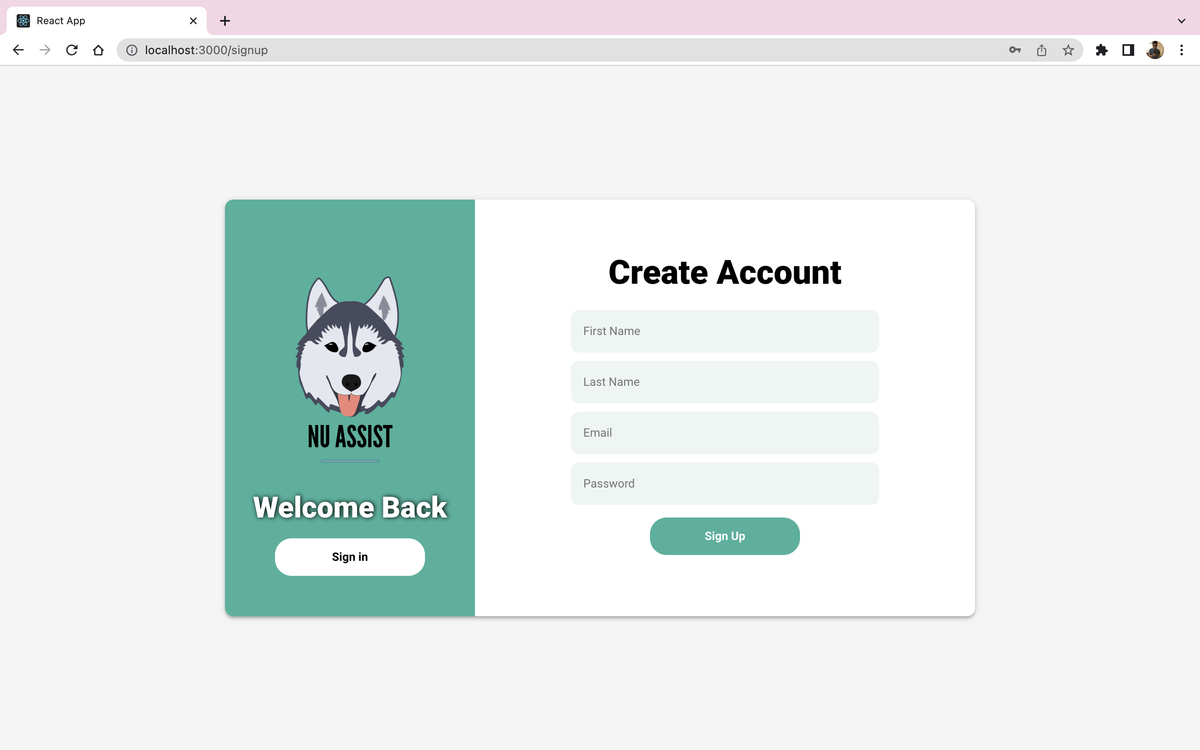
LOGIN FLOW
We have designed the website in such a way that a user who wants to explore more about northeastern university will be able to register and login to access the content.

Slide 7
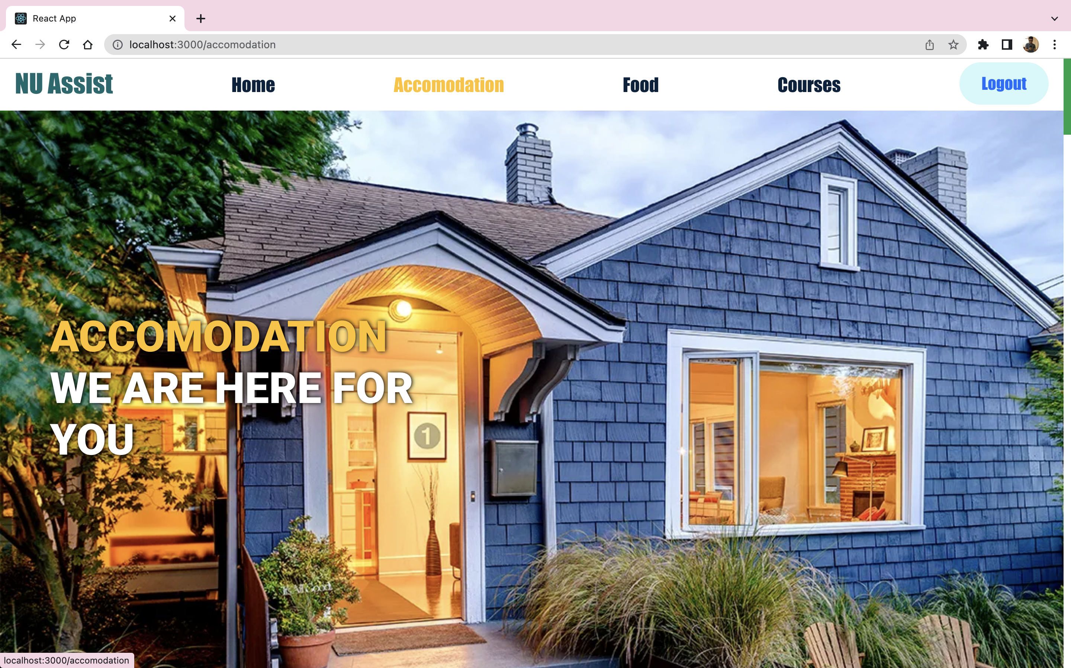
ACCOMMODATION
For an international student, this is the most challenging phase. It goes without saying that obtaining accommodation in a foreign place is tough.
The website has links that allow students to seek for housing. We've also highlighted convenient sites near the institution where they may locate accommodations.
We have included the pros and cons of the locations, price, red-eye accessibility, and so on, making it easier for students to choose housing that meets their needs.

Slide 8
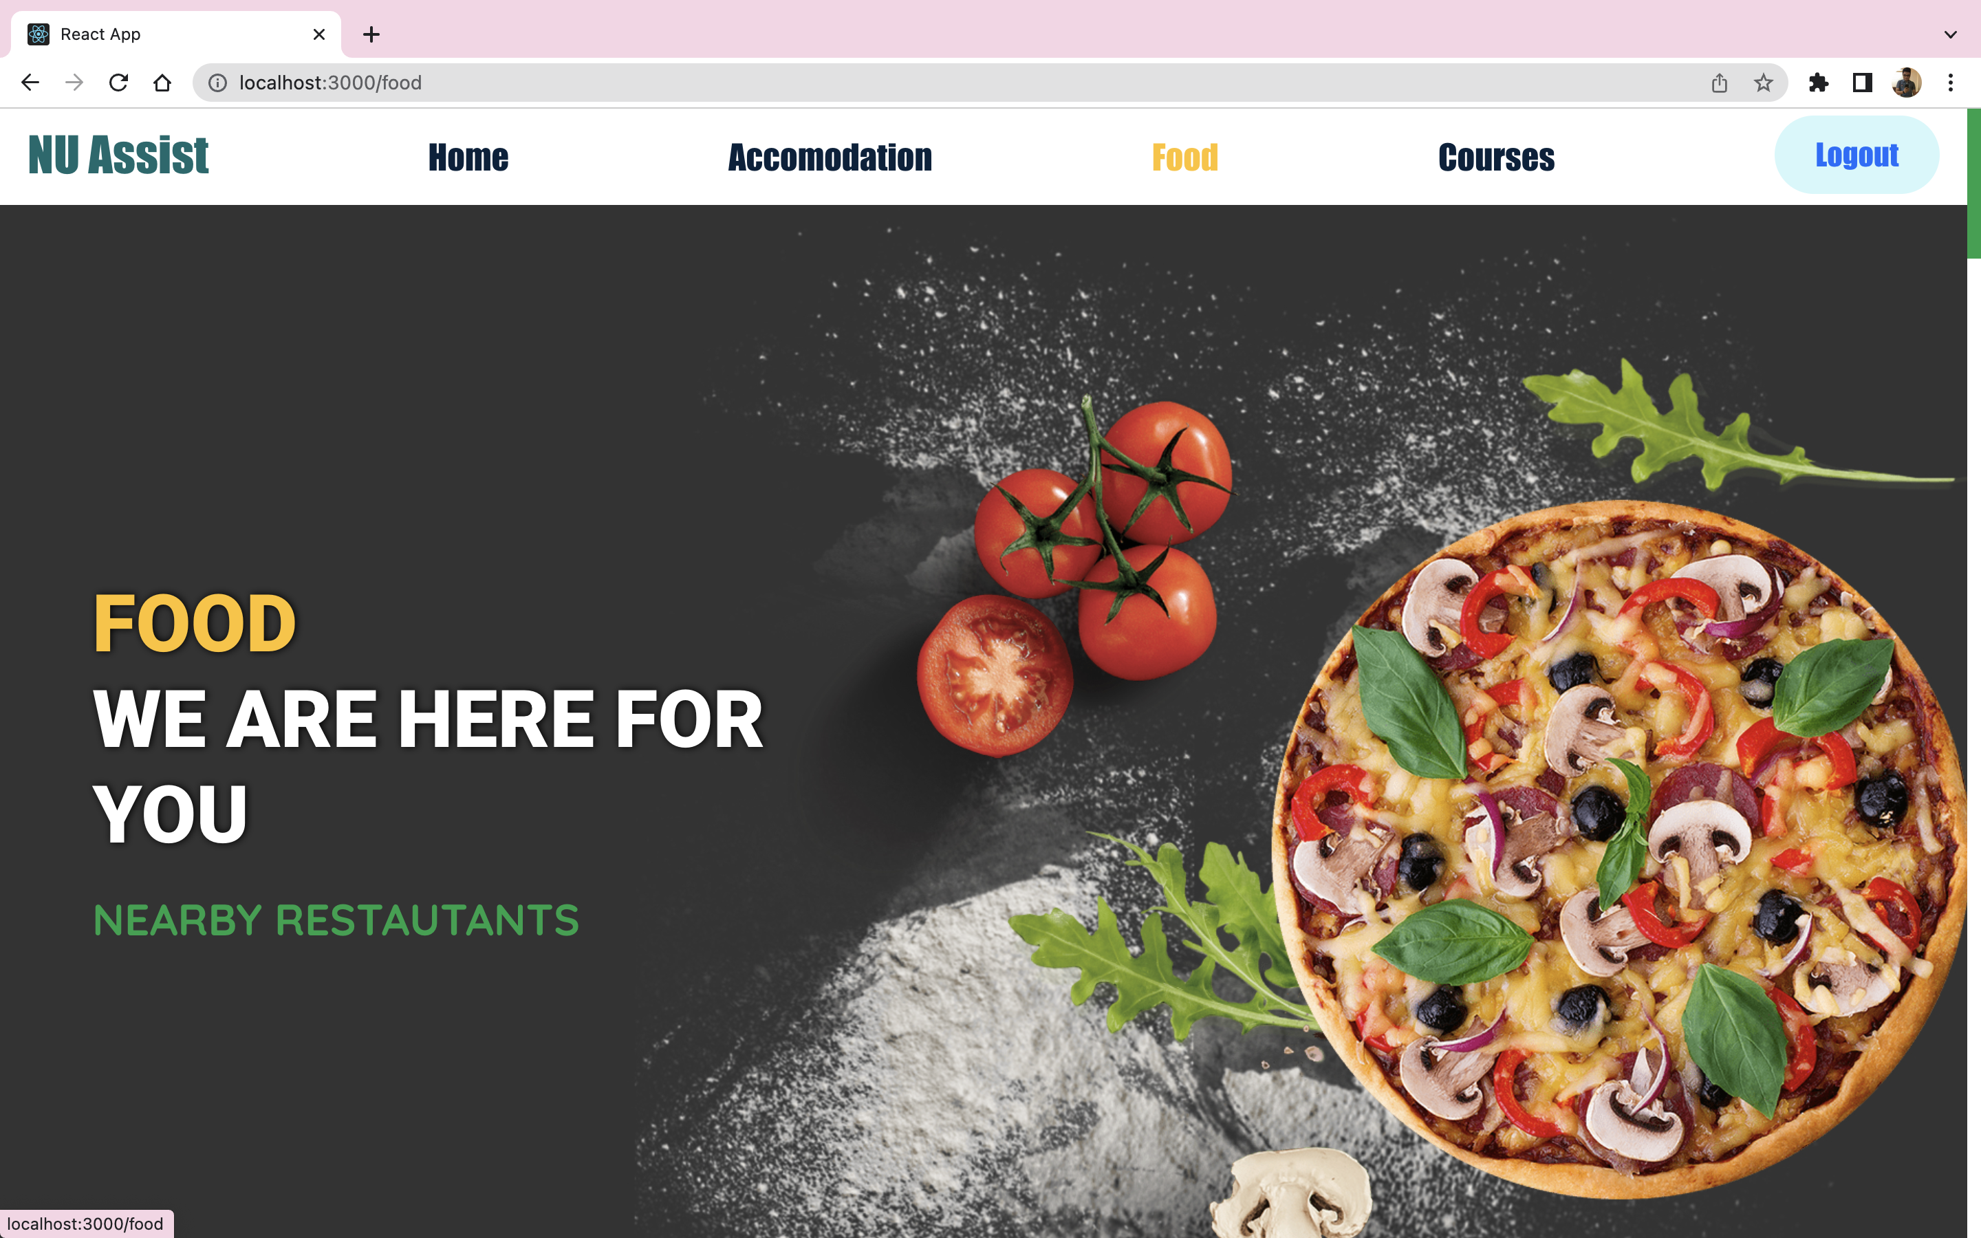
FOOD
We have included all information about Indian Restaurants on the food page.
We added several features that allow consumers to phone the restaurant or visit the restaurant's website by clicking on a link.
We put restaurant reviews at the bottom of the page to assist users in making a choice.

Slide 9
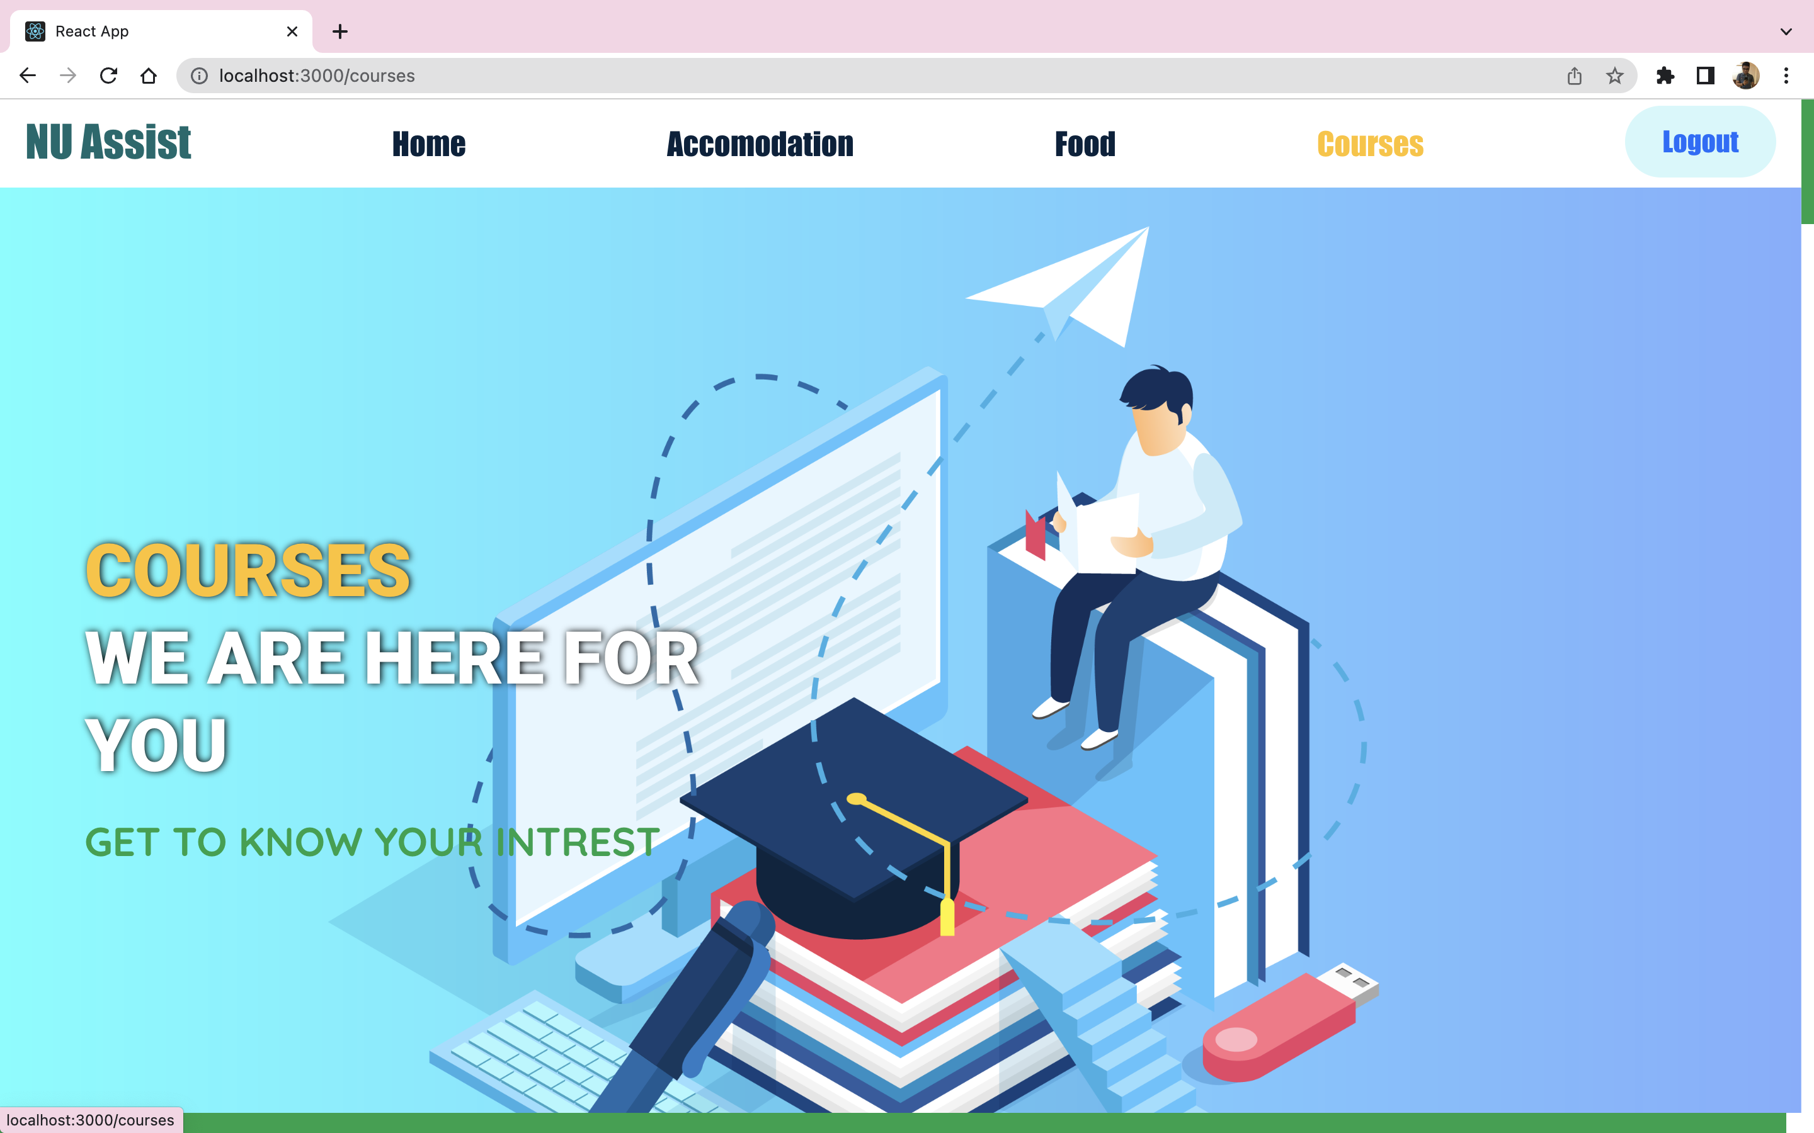
COURSE WORK
The webpage has thorough information on courses. Students can go through the electives to find courses that interest them and then register for them.
We offered information on popular courses among students such as Information Systems, Computer Science, Electrical and Computer Engineering, and Regulatory Affairs.

Slide 10
THANK YOU
HTML/CSS
Bootstrap
Javascript
React JS
Node JS
MongoDB

